Slide 1

Girl Develop It!
USER RESEARCH 102

Slide 2
Welcome Back!
Girl Develop It Virtual Course

Slide 3
AGENDA
5 MIN | Welcome & Agenda Walkthrough
25 MIN | Research Process Recap & Walkthrough
25 MIN | User Research Synthesis & Analysis (Overview)
5 MIN | Bio Break
20 MIN | Affinity Mapping/Diagramming
20 MIN | Activity: Affinity Mapping/Diagramming
15 MIN | User Personas
10 MIN | Q&A & Wrap-Up

Slide 4
01
02
03
INTRO TO USER RESEARCH
UXR OFFICE HOURS
INTRO TO USER RESEARCH 102
USER EXPERIENCE RESEARCH COMPONENTS
04
05
06
INTRO TO USABILITY TESTING
USABILITY TESTING OFFICE HOURS
USABILITY TESTING, PT. 2

Slide 5
01
02
03
INTRO TO USER RESEARCH
UXR OFFICE HOURS
INTRO TO USER RESEARCH 102
USER EXPERIENCE RESEARCH COMPONENTS
04
05
06
INTRO TO USABILITY TESTING
USABILITY TESTING OFFICE HOURS
USABILITY TESTING, PT. 2

Slide 6
LEARNING OBJECTIVES
Learning Objectives
Define our users
Interpret and frame a design challenge
Develop UX research deliverables

Slide 7

01
Research Process Recap & Walkthrough

Slide 8
DOUBLE DIAMOND PROCESS
The double diamond process illustrates the four phases of exploring a problem widely and deeply (divergence) and then taking focused action (convergence).
DESIGN THE RIGHT THING
DESIGN THINGS RIGHT
Problem
Problem/Definition
Solution
Discover
Explore/
Define
Design
Implement
Insight into the problem (Initial project and research planning, and alignment)
Primary establishment of user needs and interpretation of findings
Research-backed assets used to inform project strategy
Finalized outcome of strategy, evaluation, and feedback

Slide 9
DOUBLE DIAMOND PROCESS
The double diamond process illustrates the four phases of exploring a problem widely and deeply (divergence) and then taking focused action (convergence).
DESIGN THE RIGHT THING
DESIGN THINGS RIGHT
Problem
Problem/Definition
Solution
Discover
Explore/
Define
Design
Implement
Insight into the problem (Initial project and research planning, and alignment)
Primary establishment of user needs and interpretation of findings
Research-backed assets used to inform project strategy
Finalized outcome of strategy, evaluation, and feedback

Slide 10
HOW DO YOU DO USER RESEARCH?
Conducting user research:
Identify your stakeholders
Identify your business and research goals
Develop your plan
Execute your plan
Synthesize & analyze your findings

Slide 11
RESEARCH PLAN WALKTHROUGH
How might we develop on demand services for language learning?

Slide 12
RESEARCH PLAN WALKTHROUGH
Background: The Language Learning Center currently provides drop in services to people interested in learning courses, ranging from 1-hour, small group sessions to 3-hour one-on-one sessions. Their recent expansion into remote learning provides a unique opportunity to identify elements of their current language learning platform that could succeed in a digital environment.
How might we develop on demand services for language learning?

Slide 13
RESEARCH PLAN WALKTHROUGH
Background: The Language Learning Center currently provides drop in services to people interested in learning courses, ranging from 1-hour, small group sessions to 3-hour one-on-one sessions. Their recent expansion into remote learning provides a unique opportunity to identify elements of their current language learning platform that could succeed in a digital environment.
Business Goal: By providing online and offline options for language learners, The Language Learning Center aims to increase their customer base by 50% by the end of fiscal year 2021.
How might we develop on demand services for language learning?

Slide 14
RESEARCH PLAN WALKTHROUGH
Background: The Language Learning Center currently provides drop in services to people interested in learning courses, ranging from 1-hour, small group sessions to 3-hour one-on-one sessions. Their recent expansion into remote learning provides a unique opportunity to identify elements of their current language learning platform that could succeed in a digital environment.
Business Goal: By providing online and offline options for language learners, The Language Learning Center aims to increase their customer base by 50% by the end of fiscal year 2021.
Research Goal: To learn about the perceptions, behaviors, needs, and motivations of people who have taken at least one language course.
How might we develop on demand services for language learning?

Slide 15
RESEARCH PLAN WALKTHROUGH
Background: The Language Learning Center currently provides drop in services to people interested in learning courses, ranging from 1-hour, small group sessions to 3-hour one-on-one sessions. Their recent expansion into remote learning provides a unique opportunity to identify elements of their current language learning platform that could succeed in a digital environment.
Business Goal: By providing online and offline options for language learners, The Language Learning Center aims to increase their customer base by 50% by the end of fiscal year 2021.
Research Goal: To learn about the perceptions, behaviors, needs, and motivations of people who have taken at least one language course.
Stakeholders: The Language Learning Center staff (instructors, business manager, tech team)
How might we develop on demand services for language learning?

Slide 16
RESEARCH PLAN WALKTHROUGH
Background: The Language Learning Center currently provides drop in services to people interested in learning courses, ranging from 1-hour, small group sessions to 3-hour one-on-one sessions. Their recent expansion into remote learning provides a unique opportunity to identify elements of their current language learning platform that could succeed in a digital environment.
Business Goal: By providing online and offline options for language learners, The Language Learning Center aims to increase their customer base by 50% by the end of fiscal year 2021.
Research Goal: To learn about the perceptions, behaviors, needs, and motivations of people who have taken at least one language course.
Stakeholders: The Language Learning Center staff (instructors, business manager, tech team)
Methodology: 1:1 semi-structured qualitative interviews with 10 interviewees with language learners: 5 existing customers of The Language Center and 5 prospective language learners.
How might we develop on demand services for language learning?

Slide 17
RESEARCH PLAN WALKTHROUGH
Background: The Language Learning Center currently provides drop in services to people interested in learning courses, ranging from 1-hour, small group sessions to 3-hour one-on-one sessions. Their recent expansion into remote learning provides a unique opportunity to identify elements of their current language learning platform that could succeed in a digital environment.
Business Goal: By providing online and offline options for language learners, The Language Learning Center aims to increase their customer base by 50% by the end of fiscal year 2021.
Research Goal: To learn about the perceptions, behaviors, needs, and motivations of people who have taken at least one language course.
Stakeholders: The Language Learning Center staff (instructors, business manager, tech team)
Methodology: 1:1 semi-structured qualitative interviews with 10 interviewees with language learners: 5 existing customers of The Language Center and 5 prospective language learners.
Interviewer(s): Ida the Interviewer
How might we develop on demand services for language learning?

Slide 18
RESEARCH PLAN WALKTHROUGH
Background: The Language Learning Center currently provides drop in services to people interested in learning courses, ranging from 1-hour, small group sessions to 3-hour one-on-one sessions. Their recent expansion into remote learning provides a unique opportunity to identify elements of their current language learning platform that could succeed in a digital environment.
Business Goal: By providing online and offline options for language learners, The Language Learning Center aims to increase their customer base by 50% by the end of fiscal year 2021.
Research Goal: To learn about the perceptions, behaviors, needs, and motivations of people who have taken at least one language course.
Stakeholders: The Language Learning Center staff (instructors, business manager, tech team)
Methodology: 1:1 semi-structured qualitative interviews with 10 interviewees with language learners: 5 existing customers of The Language Center and 5 prospective language learners.
Interviewer(s): Ida the Interviewer
Interview Date(s): July 1 - 5, 2021
How might we develop on demand services for language learning?

Slide 19
RESEARCH PLAN SCENARIO
As a small business that primarily offered in-person drop in language services, The Language Center had a vested interest in moving their language learning sessions online due to in-person restrictions on the number of customers they could have in their building at any one time.
They hired a UX Designer to help them design a website that could list all of their courses, with the times they regularly occur. The Language Center emphasized that, due to how urgent their need was, they only wanted the UX Designer to make the site “pop” for visitors so that it would draw people to their site. They did not have time to ask their new or existing customers about their preferences.
The UX Designer finished the design of the site and launched it. While existing customers selected times that worked for them, The Language Center did not acquire the new customers they thought they were going to get.
What could go wrong?

Slide 20
RESEARCH PLAN WALKTHROUGH
As a small business that primarily offered in-person drop in language services, The Language Center had a vested interest in moving their language learning sessions online due to in-person restrictions on the number of customers they could have in their building at any one time.
They hired a UX Designer to help them design a website that could list all of their courses, with the times they regularly occur. The Language Center emphasized that, due to how urgent their need was, they only wanted the UX Designer to make the site “pop” for visitors so that it would draw people to their site. The UX Designer ensured the business owners that by asking a few customers what their needs and pain points were, these insights could help align their business goals with the site’s design.
Through research, the UX Designer discovered that while existing customers were able to select courses they were interested in taking, new customers struggled to assess their language skill level. The UX Designer, along with Language Center stakeholders, incorporated an assessment tool which made new customers feel confident in signing up for courses. When the site launches, The Language Center did acquire the new customers to meet their business goal.
What could go right?

Slide 21

02
User Research Synthesis & Analysis

Slide 22
SYNTHESIZE & ANALYZE YOUR FINDINGS
Questions to consider:
What patterns emerge?
What themes emerge?
What insights did you learn?
How does this answer the research question/goal?

Slide 23
SYNTHESIZE & ANALYZE YOUR FINDINGS
Questions to consider:
What patterns emerge?
What themes emerge?
What insights did you learn?
How does this answer the research question/goal?
Example synthesis/analysis methods:
Thematic analysis
User journey mapping
Storyboard development
Affinity diagramming/mapping
Persona development

Slide 24
SYNTHESIZE & ANALYZE YOUR FINDINGS
Questions to consider:
What patterns emerge?
What themes emerge?
What insights did you learn?
How does this answer the research question/goal?
Example synthesis/analysis methods:
Thematic analysis
User journey mapping
Storyboard development
Affinity diagramming/mapping
Persona development

Slide 25
SYNTHESIZE & ANALYZE YOUR FINDINGS
Synthesis & Analysis Methods:
Thematic analysis:
One of the most common forms of analysis in qualitative research
Tag individual observations and quotations using codes to discover themes
A theme emerges when findings appear multiple times across data (e.g. participant observations)
User journey mapping:
Helps visualize the different interactions, or touchpoints, a user may have with your product and/or service in order to reach their goal
Typically compiled in a timeline, from the start of the user’s process to the end where they reach their goal
Includes journey phases, emotions, and actions
Storyboard development:
Communicate a series of states rather than a specific direction
Demonstrate how someone would interact with the product or service
Communicate a part of the user journey

Slide 26
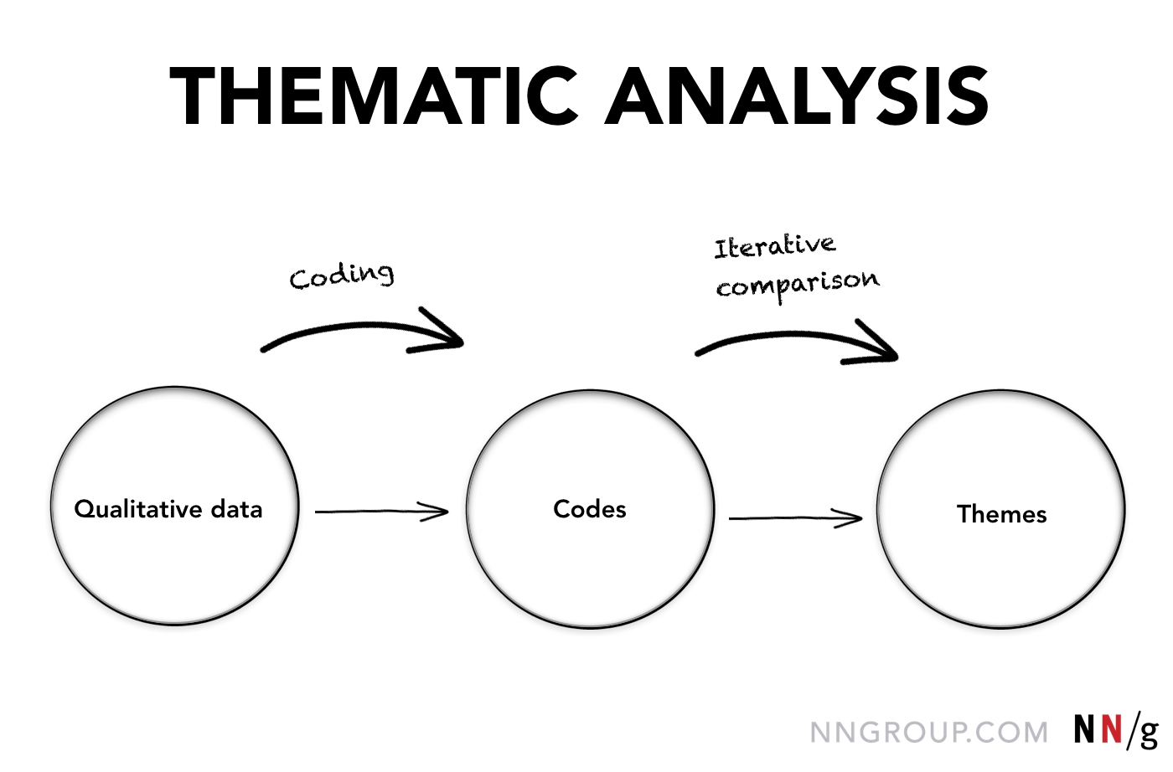
SYNTHESIS & ANALYSIS METHODS
Thematic Analysis:
One of the most common forms of analysis in qualitative research
Tag individual observations and quotations using codes to discover themes
A theme emerges when findings appear multiple times across data (e.g. participant observations)
Maria Rosala. How to Analyze Qualitative Data from UX Research: Thematic Analysis
<https://www.nngroup.com/articles/thematic-analysis/>. September 29, 2019

Slide 27
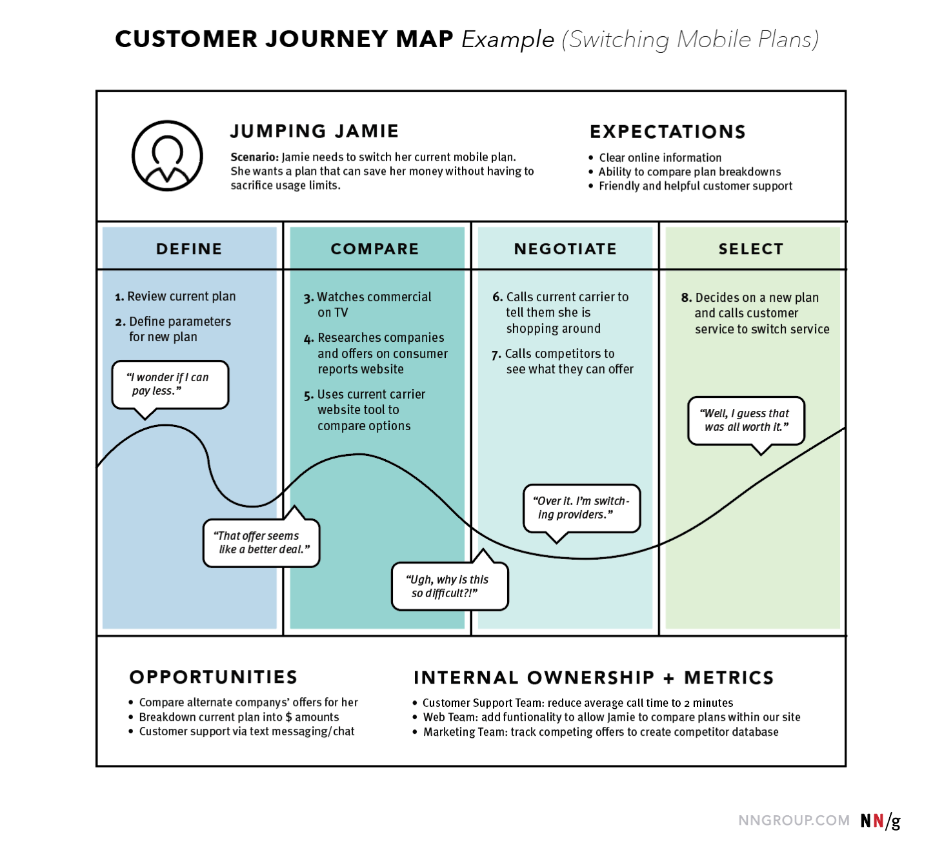
SYNTHESIS & ANALYSIS METHODS
User Journey Mapping:
Helps visualize the different interactions, or touchpoints, a user may have with your product and/or service in order to reach their goal
Typically compiled in a timeline, from the start of the user’s process to the end where they reach their goal
Includes journey phases, emotions, and actions
Sarah Gibbons. Journey Mapping 101.
<https://www.nngroup.com/articles/journey-mapping-101/>. December 9, 20198

Slide 28
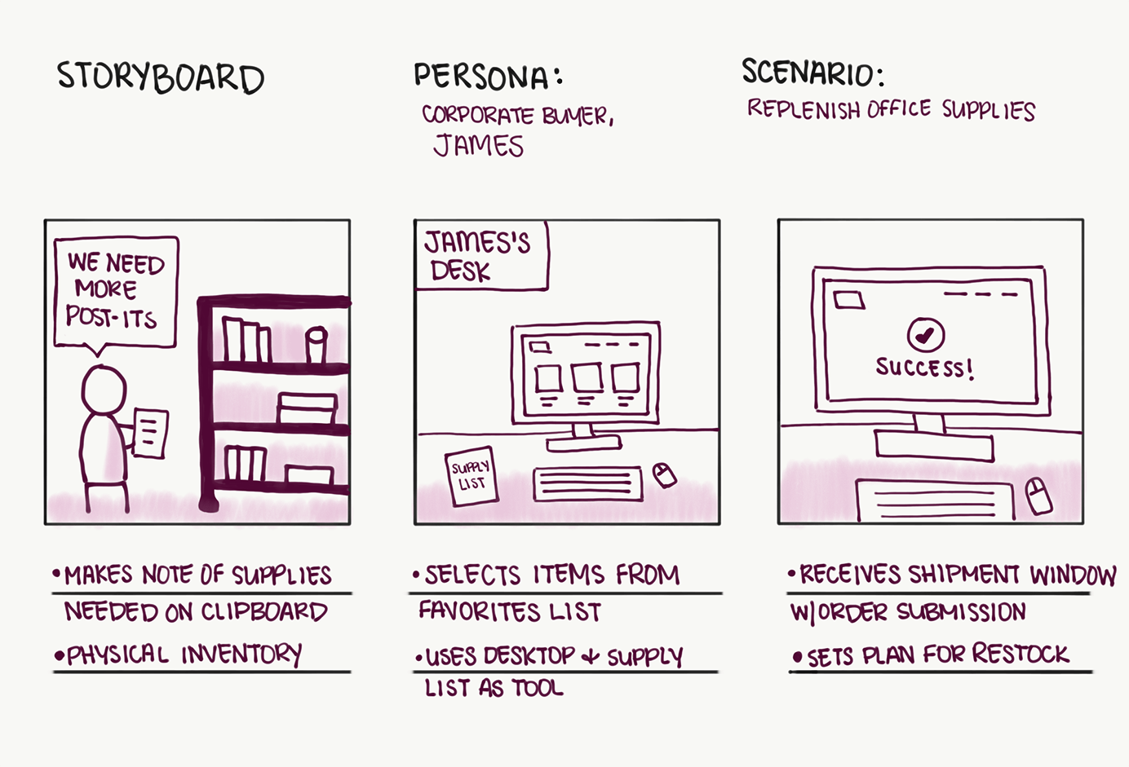
SYNTHESIS & ANALYSIS METHODS
Storyboard Development:
Communicate a series of states rather than a specific direction
Demonstrate how someone would interact with the product or service
Communicate a part of the user journey
Rachel Krause. Storyboards Help Visualize UX Ideas.
<https://www.nngroup.com/articles/storyboards-visualize-ideas/>. July 15, 20198

Slide 29
Break Time!
5 minutes

Slide 30
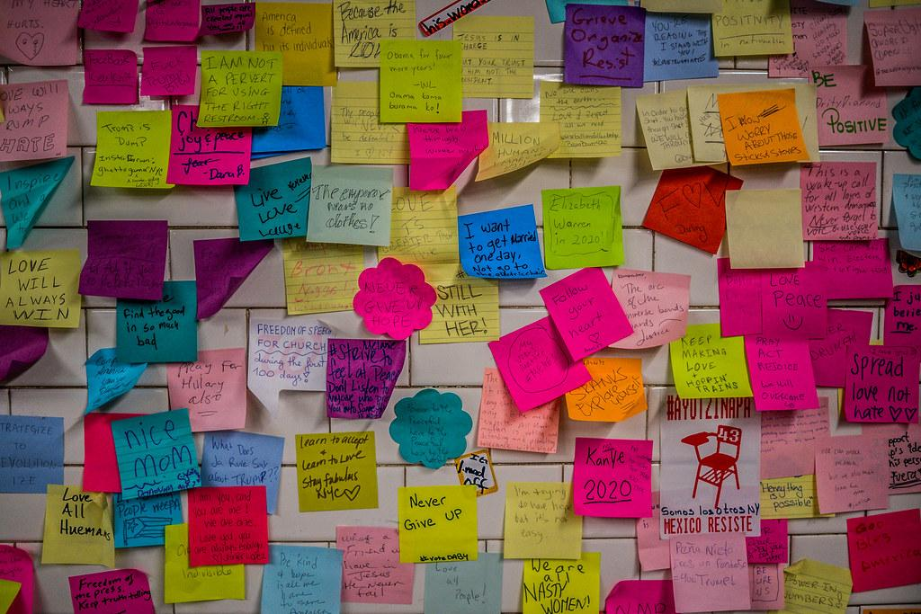
03
Affinity Mapping/
Diagramming

Slide 31
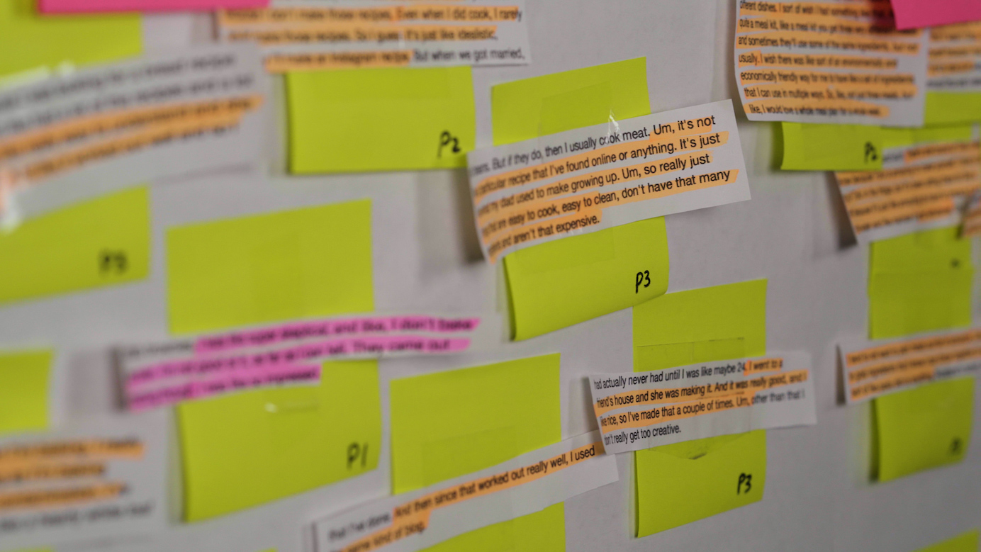
AFFINITY DIAGRAMMING/MAPPING
Affinity Mapping/Diagramming Overview
Helps you organize large amounts of data
Visualize patterns in the data (physically or digitally)
Identify insights from findings / identify what you learned
Use the data to see how it answers your business and/or research goal (or design challenge)

Slide 32
AFFINITY DIAGRAMMING/MAPPING
Affinity Mapping/Diagramming Benefits
Visual method of pattern making with data
Relatively quick way of deriving themes
Flexible: can be done alone or with other people
Affinity Mapping/Diagramming Drawbacks
Not as thorough as other methods (e.g. thematic analysis)
Organizing a lot of varied data can become complicated (especially, with many people)

Slide 33
AFFINITY DIAGRAMMING/MAPPING
Person 1
Person 2
Person 3
“The first time I started going to TLC, an admissions person helped me assess my skill level.”
“I’m shy and don’t really like to mingle with people, so I take 30 minutes courses and then I can go about my day.”
“I love meeting how flexible the drop in format for classes is… it really works for my erratic schedule!”
“The teachers are lovely and I appreciate how flexible they are given my time constraints.”
“I’m taking the 3 hour class multiple times a week to prepare for my vacation.”
“When I first signed up, I had no clue what I was doing. I was in the wrong course!”
“I wish they offered more night time courses. I know the teachers have to sleep but I’m a night owl.”
“The teacher said I was doing very well in the course and recommended me to a more advanced course.”

Slide 34
AFFINITY DIAGRAMMING/MAPPING
“The first time I started going to TLC, an admissions person helped me assess my skill level.”
“I love meeting how flexible the drop in format for classes is… it really works for my erratic schedule!”
“I’m shy and don’t really like to mingle with people, so I take 30 minutes courses and then I can go about my day.”
“When I first signed up, I had no clue what I was doing. I was in the wrong course!”
“The teachers are lovely and I appreciate how flexible they are given my time constraints.”
“I’m taking the 3 hour class multiple times a week to prepare for my vacation.”
“The teacher said I was doing very well in the course and recommended me to a more advanced course.”
“I wish they offered more night time courses. I know the teachers have to sleep but I’m a night owl.”

Slide 35
AFFINITY DIAGRAMMING/MAPPING
Assessment of Language Skills
Flexibility in Course Structure
“The first time I started going to TLC, an admissions person helped me assess my skill level.”
“The teacher said I was doing very well in the course and recommended me to a more advanced course.”
“I’m shy and don’t really like to mingle with people, so I take 30 minutes courses and then I can go about my day.”
“The teachers are lovely and I appreciate how flexible they are given my time constraints.”
“When I first signed up, I had no clue what I was doing. I was in the wrong course!”
“I wish they offered more night time courses. I know the teachers have to sleep but I’m a night owl.”
“I love meeting how flexible the drop in format for classes is… it really works for my erratic schedule!”
Goals of Language Learners
“I’m taking the 3 hour class multiple times a week to prepare for my vacation.”

Slide 36
AFFINITY DIAGRAMMING/MAPPING
Assessment of language skills is critical to successful language learning
Customers prefer course which meet the flexible needs of their personal lives
“The first time I started going to TLC, an admissions person helped me assess my skill level.”
“The teacher said I was doing very well in the course and recommended me to a more advanced course.”
“I’m shy and don’t really like to mingle with people, so I take 30 minutes courses and then I can go about my day.”
“The teachers are lovely and I appreciate how flexible they are given my time constraints.”
“When I first signed up, I had no clue what I was doing. I was in the wrong course!”
Customers have specific goals for language learning
“I wish they offered more night time courses. I know the teachers have to sleep but I’m a night owl.”
“I love meeting how flexible the drop in format for classes is… it really works for my erratic schedule!”
“I’m taking the 3 hour class multiple times a week to prepare for my vacation.”

Slide 37
AFFINITY DIAGRAMMING/MAPPING
Assessment of language skills is critical to successful language learning
Customers prefer course which meet the flexible needs of their personal lives
“The first time I started going to TLC, an admissions person helped me assess my skill level.”
“The teacher said I was doing very well in the course and recommended me to a more advanced course.”
“I’m shy and don’t really like to mingle with people, so I take 30 minutes courses and then I can go about my day.”
“The teachers are lovely and I appreciate how flexible they are given my time constraints.”
“When I first signed up, I had no clue what I was doing. I was in the wrong course!”
Customers have specific goals for language learning
“I wish they offered more night time courses. I know the teachers have to sleep but I’m a night owl.”
“I love meeting how flexible the drop in format for classes is… it really works for my erratic schedule!”
“I’m taking the 3 hour class multiple times a week to prepare for my vacation.”
This might be an area where more research is needed.

Slide 38
Activity Time!
20 minutes

Slide 39
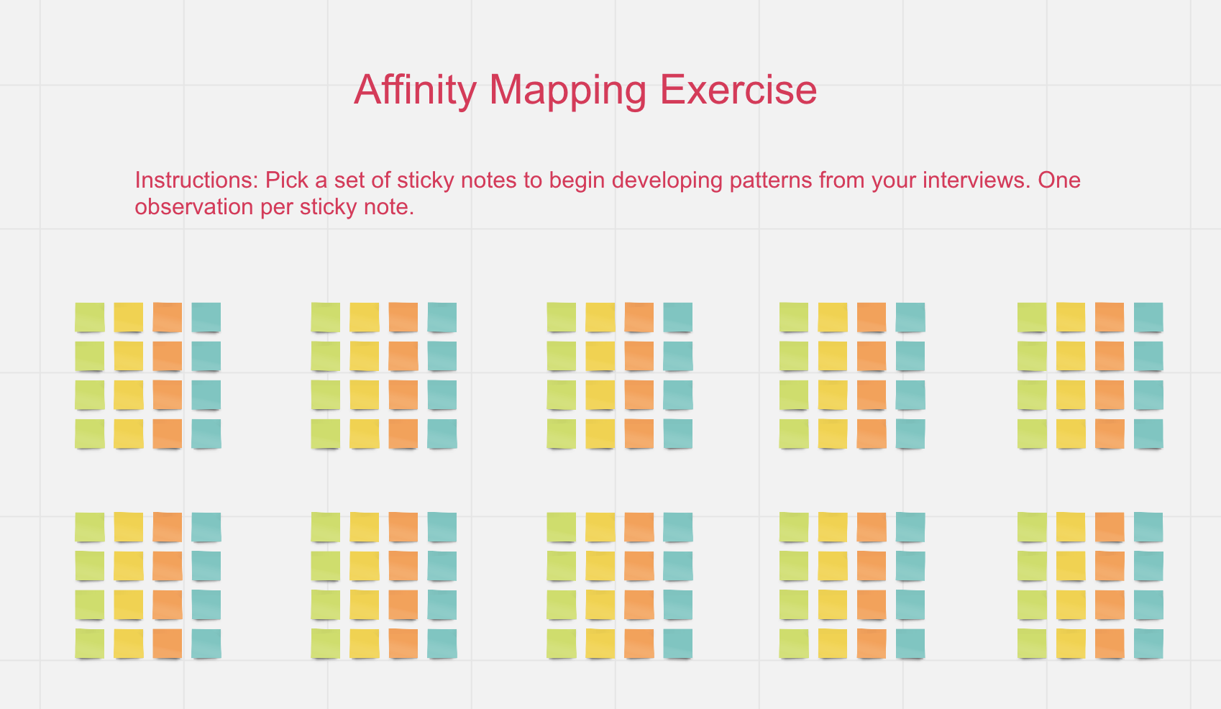

MIRO ORIENTATION

Slide 40
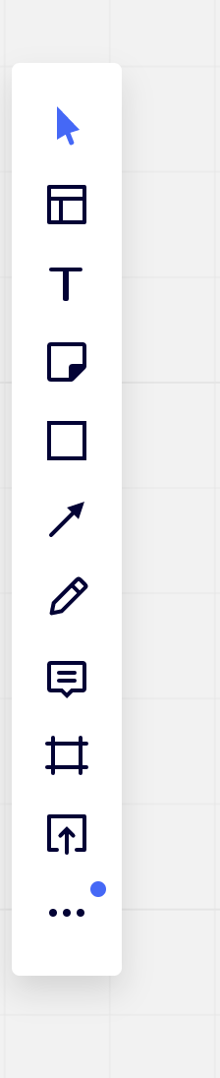
MIRO ORIENTATION
Add text
Add “Post-Its”

Slide 41
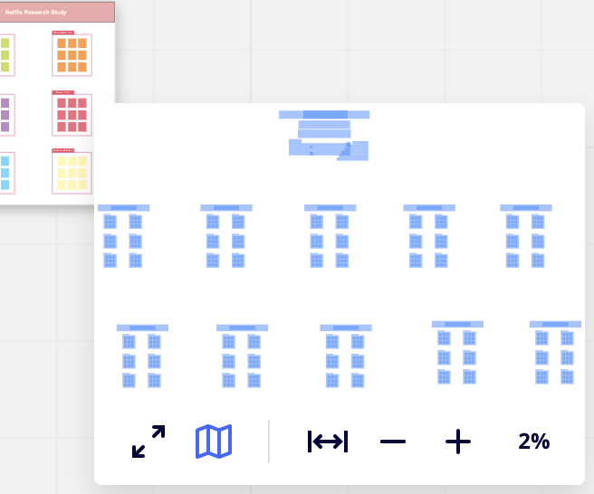
MIRO ORIENTATION
Add text
Add “Post-Its”
Zoom in (+) and out (-) on board

Slide 42
SYNTHESIZE & ANALYZE YOUR FINDINGS
Questions to consider:
What patterns emerge?
What themes emerge?
What insights did you learn?
How does this answer the research question/goal?

Slide 43
SYNTHESIZE & ANALYZE YOUR FINDINGS
Based on the emerging themes, you should be able to:
Redefine the problem statement based on the insights you discovered
Articulate the direction of your design:
What problem am I trying to solve?
What do customers say they want and/or need?
What is the customer’s main need?
How does this fit into or address their current behavior?

Slide 44

04
Persona Development

Slide 45
USER PERSONAS
User Personas:
Are a representation of your ideal customer/user
Built upon the aggregated data to provide a realistic representation of the user
Are commonly used to represent real people in order to build empathy with stakeholders (they’re not just looking at data points but real people)
Incorporate the personality traits, behaviors, goals and/or needs, and pain points of the people you spoke to during the research phase

Slide 46
USER PERSONA
A biography of the person you spoke to: what do they do. What is their relationship to the stakeholder, if any?
IMAGE
What are their goals as they relate to the research goal?
Name & Age
Traits that might be relevant to answering your research question.
What are some pain points they experience as the try to meet their goals?

Slide 47

USER PERSONA
Bio
Shannon Johnson is a 38 year old employee of well known international non-profit organization. In her role, she enjoys traveling, getting to know the people she works with in other locations, and helping people. She has been taking courses off and on at The Language Center for 2 years, starting off as a beginner in the Spanish language cohort and now working her way up to being an intermediate learner.
Shannon Johnson | 38
Goals
Using her language skills on work and leisure trips
Bonding with new people where she lives
Growing professionally in her career
SPANISH COHORT LANGUAGE LEARNER
Personality Traits
Impatient
Gets along well with strangers
Loves to travel
Always desires to stay active
Enjoys eating out when traveling
Pain Points
Finding a course that’s available at the last minute
Long-term courses that don’t feel like they have an end
Feeling stagnant in her professional development

Slide 48
Questions?

Slide 49
RESOURCES
How to Create an Affinity Diagram for UX Research | Zach Naylow
https://zacknaylor.medium.com/how-to-create-an-affinity-diagram-for-ux-research-cdc08489952d
Why Personas Fail | Nielsen Norman Group
https://www.youtube.com/watch?v=fal4Wylyt3M
Complete Beginner’s Guide to UX Research | UX Booth
https://www.uxbooth.com/articles/complete-beginners-guide-to-design-research/#methodologies
User Defenders (Podcast) | Jason Ogle
https://userdefenders.com/

Slide 50
THANK YOU!
Feel free to contact me at:
nechari.riley@gmail.com
Twitter @necharism

